Slide 1

Causal Inference in Machine Learning
1
Notes:
1

Slide 2
What is causality
2
Notes:
2

Slide 3
Overview
3
Notes:
3

Slide 4
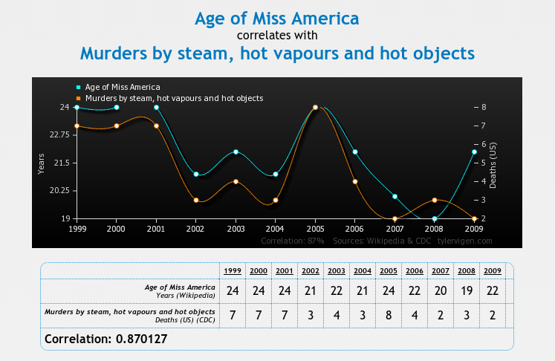
Correlation and Causation
Image source: www.tylervigen.com/
4
Notes:
4

Slide 5
Why do we care?
5
Notes:
5

Slide 6
Approaches to learning to act
Reinforcement Learning - Just do it!
Observational Causal Inference
6
Notes:
6

Slide 7
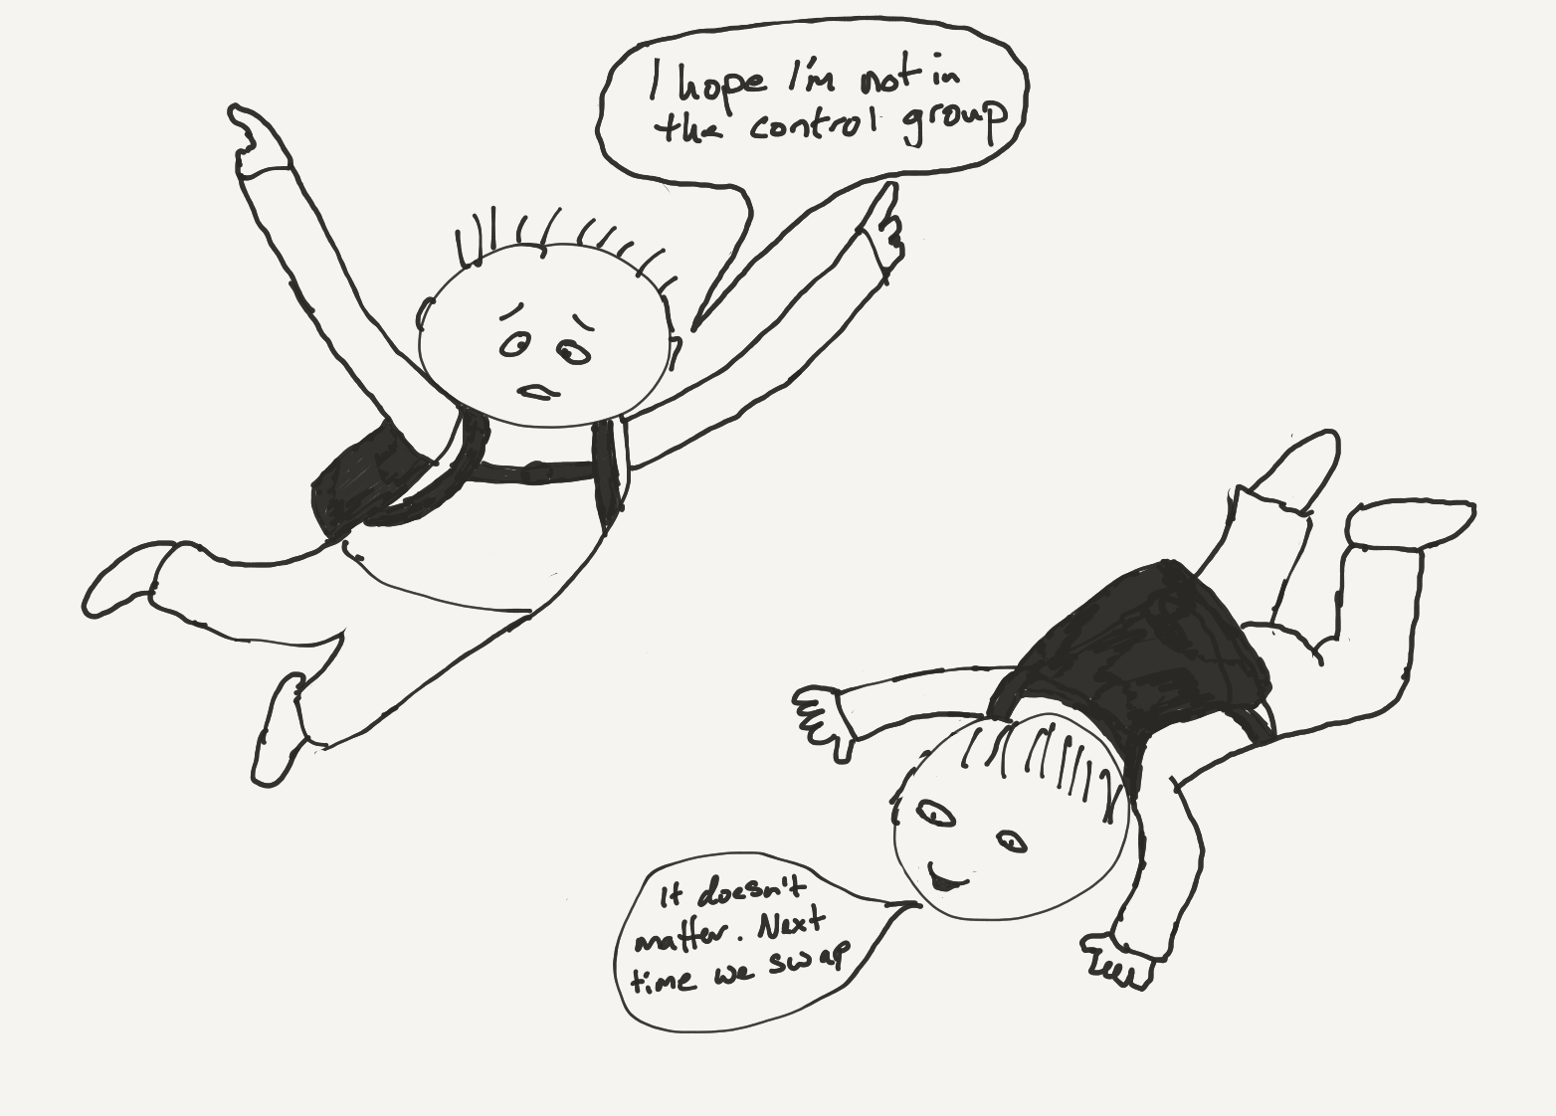
Limitations of learning only from interventions
Sometimes intervention is very costly – or impossible to do at an individual level (eg raise ban on alcohol sales to 21 for every 2nd person.
In many cases there are just two many possible options to explore.
A lot of data collected for other purposes
7
Notes:
7

Slide 8
Observational causal inference
8
Notes:
8

Slide 9
Causal Bayesian Networks
Truncated product formula: drop terms for intervened variables from the factorisation.
A CBN represents the set of all possible interventional distributions over its variables
9
Notes:
9
high light what remains invariant

Slide 10
The do calculus (simplified)
10
Notes:
10
Things are more interesting when there are latent variables
The do notation is just a notation – the question is can properties of one system be inferred from another.
Explain the localisation property of d-separation.
The do calculus is complete

Slide 11
Identifiability
11
Notes:
11
Things are more interesting when there are latent variables
The do notation is just a notation – the question is can properties of one system be inferred from another.
Explain the localisation property of d-separation.
The do calculus is complete

Slide 12
Inference from observational data – aka Pearl
12
Notes:
12

Slide 13
Can’t we just be Bayesian?
13
Notes:
13

Slide 14
Careful with that prior
The goal is to estimate the causal effect of X on Y
It is indefinable via the do-calculus
OLS is unbiased
14
Notes:
14

Slide 15
Pesky statistical issues
15
Notes:
15

Slide 16
What is the objective?
What question do we actually want to answer?
16
Notes:
16

Slide 17
Other causal frameworks
Counterfactuals
Structural equation models
Granger causality
17
Notes:
17

Slide 18
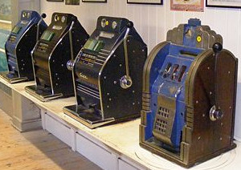
Causal Inference and Bandits
Randomized trials are the traditional gold standard for determining causality
Bandits algorithms can be seen as an improvement on randomized trials that leverage the sequential nature of the decision process.
18
Notes:
18

Slide 19
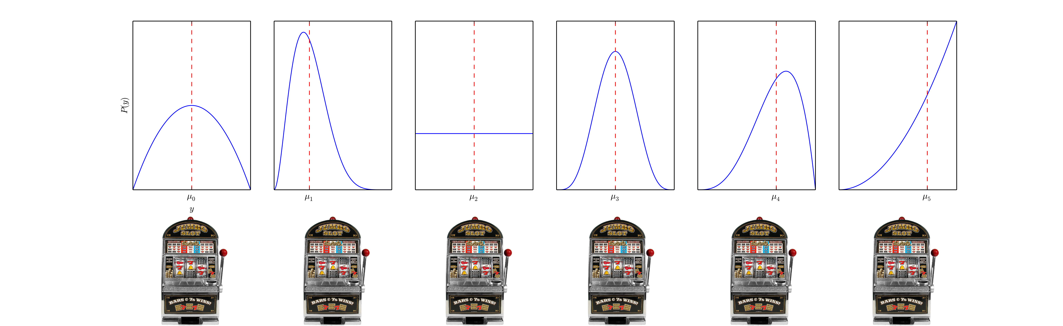
Classic Multi-armed Bandits
Randomized trials are the traditional gold standard for determining causality
Bandit definition
Regret
19
Notes:
19

Slide 20
Key Challenges
Non-i.i.d data
Explore-exploit trade-off
20
Notes:
20

Slide 21
Approaches to Designing Bandit Algorithms
Confidence Bounds
– must use inequalities as distributions are unknown
- Union bounds – bound must hold with high probability for all arms
Optimisation
Elimination Algorithms
21
Notes:
21

Slide 22
More Bandit Problems
Adversarial
Contextual
Off-Policy Evaluation
Simple Regret
22
Notes:
22

Slide 23
Key Results for Bandit Problems
Regret Bounds – Problem dependent & independent. How they scale with key quantities.
23
Notes:
23

Slide 24
Causal structure of bandit problems
Contextual bandit algorithms do not require that the context is a cause of the outcome.
24
Notes:
24

Slide 25
Causal Bandit Problems
Every (allowable) assignment of variables to values is a bandit arm.
Reward is value of a single specified node in the graph after the action.
25
Notes:
25

Slide 26
The anatomy of causal bandit problems
How do they relate to existing bandit settings?
Take on characteristics of different settings depending on what is observed and when.
26
Notes:
26

Slide 27
C-Bandit problems with post-action feedback
27
Notes:
27

Slide 28
The parallel bandit problem
28
Notes:
28

Slide 29
The parallel bandit problem - algorithm
Observe for first T/2 rounds to estimate reward for actions that occur frequently naturally.
Uniformly explore infrequent actions in remaining rounds.
But how do we define infrequent?
29
Notes:
29
There are m(q) infrequent arms, so T/2m samples for them. The remaining arms also get ~T/2m samples because they occur with probability > 1/m(q) during observe phase.
These definition for m assumes we do some relabelling such that the q_i’s are <= .5 and ordered – does not effect generality.
We do not assume m(q) is known – estimate this from the first T/2 rounds

Slide 30
The parallel bandit problem – regret bounds
Parallel bandit
Standard bandit
30
Notes:
30
See that the approach is order optimal (worst case).

Slide 31
General graphs - challenges
We could map from observation to intervention via the do-calculus but,
Its no longer optimal ignore the information intervening on one variable can provide about another.
31
Notes:
31

Slide 32
General graphs - challenges
32
Notes:
32
The point is that P(X_2 = 1) = 0.5

Slide 33
General graphs - solution
33
Notes:
33
This is a strong assumption – but there are cases in which it is realistic, ie a company may be able to control a range of levers and know how each of these levers impact a number of characteristics of their business – but not how some external quantity might respond.

Slide 34
General graphs - solution
Solve via convex optimization
34
Notes:
34
m(eta*) is the minimum worst-case variance of the importance weighted estimator – also an effective number of arms.

Slide 35
General graphs – example
35
Notes:
35
m(eta*) is the minimum worst-case variance of the importance weighted estimator – also an effective number of arms.

Slide 36
General graphs – experiments
36
Notes:
36
m(eta*) is the minimum worst-case variance of the importance weighted estimator – also an effective number of arms.

Slide 37
Quantifying the value of intervention
37
Notes:
37

Slide 38
Summary & Future Work
38
Notes:
38
The optimism principle breaks when we have information sharing across arms.
There is a general principle that could be applied to minimize Bayesian regret – Information direct sampling
Its important to put these two parts together because, from a bandit perspective, structure is needed to make learning how to act feasible in realistic problems with many potential variables to control – and potentially exponentially many actions - and from a observational causal inference perspective because not everything can be learnt from observational data.
Could we use the corelling bandit approach – such that if the assumption is wrong we switch to using the better estimation method?

Slide 39
Questions
39
Notes:
39

Slide 40
A map of the literature
40
Notes:
40

Slide 41
Simpson’s Paradox
41
Notes:
41

